Slide 1
A Brief History Of Decentralized Exchange
Tom Schmidt | me@tomhschmidt.com

Slide 2
Overview
Why decentralized exchange?
WTF does decentralized mean?
Pre-Ethereum Era
Current Era
Visions of a Decentralized Future

Slide 3


Slide 4
Why Decentralized Exchange?
Centralized exchange hacks are rampant. Self-custody removes this concern.
Lack of KYC to serve all customers and all assets.
Programmatic access to liquidity (“Money K’Nex”)
Enable longtail and ephemeral markets (Augur markets, NFTs, etc.).
Exchange | Amount Stolen
Mt. Gox | $700MM
Coincheck | $530MM
Bitfinex | $120MM
Binanace | $27MM

Slide 5

WTF does “decentralized” mean?
Asset custody, asset listing, liquidity, and trade execution can all either be centralized or decentralized.
Different approaches have different trade-offs. Lumping all under “DEX” for this preso.

Slide 6


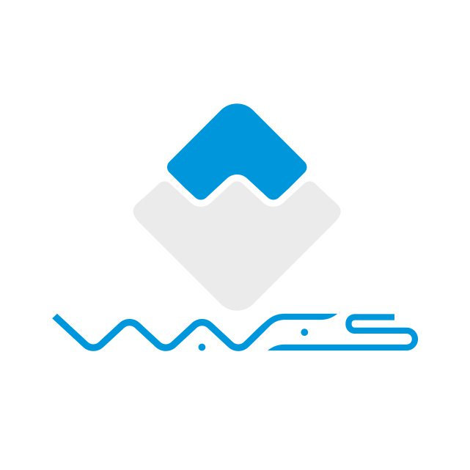



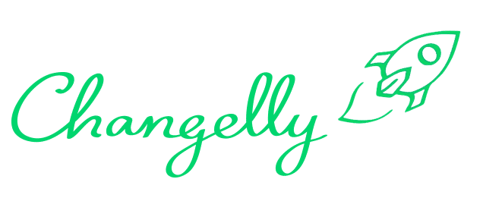
2011
HTLC
Native
Ring Exchange
Now

Slide 7
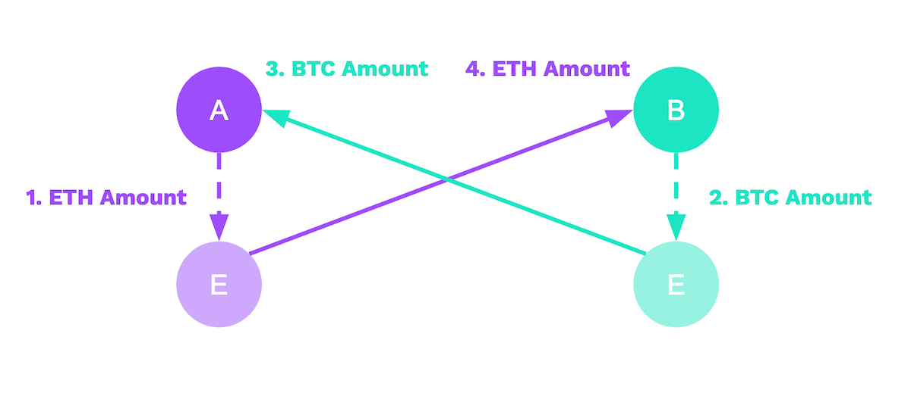
HTLC (“Hash Time Locked Contracts”)
A way to trustlessly perform atomic swaps of any two assets.
Terms are negotiated off-chain with counterparty. Simplified through platforms like Bisq and LocalBitcoins.
Expensive, slow, and inflexible, but robust and tested.

Slide 8

Ring Exchanges
Send funds into a controlled address and wait for counterparty trade to come.
Not really decentralized or trustless, but previously thought to avoid custody and therefore not be regulated as an exchange.
Volume declined since various KYC implementations and hacks.

Slide 9
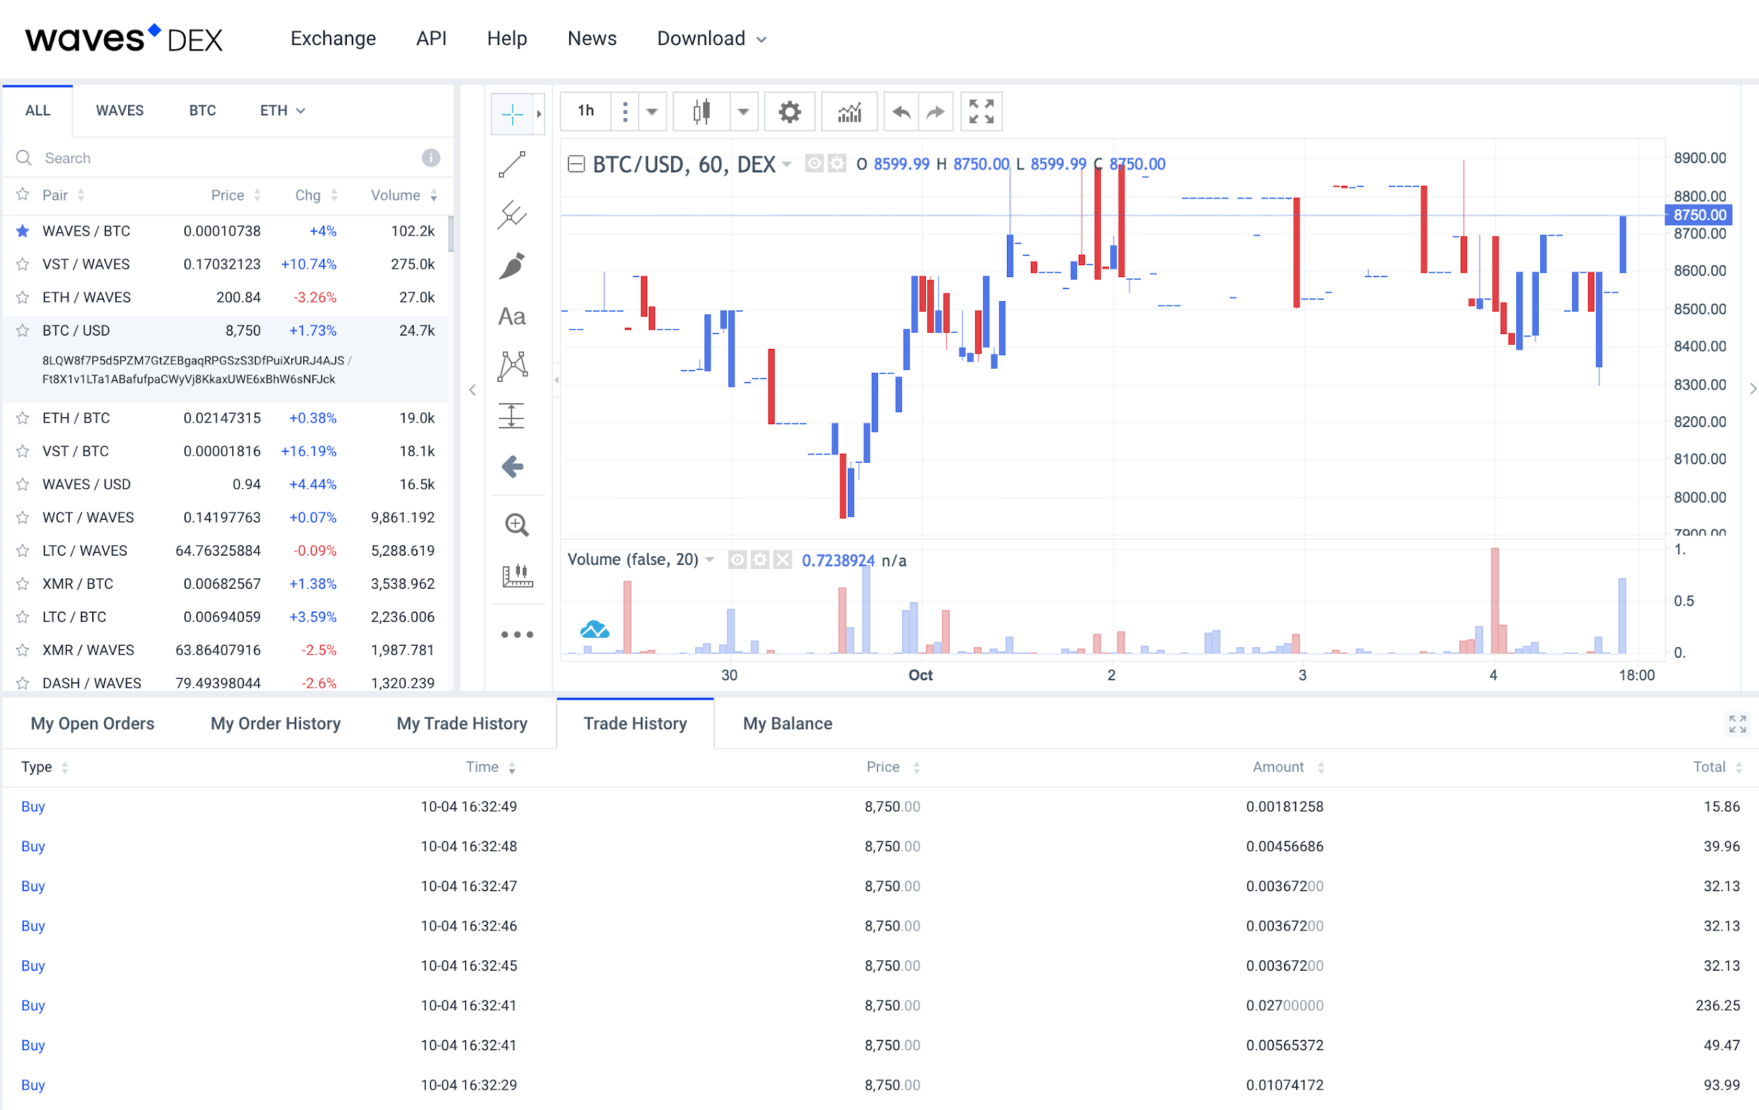
Native
All exchange operations performed on-chain, thus open to all people and assets.
Custom blockchains (BitShares, Waves) built to handle throughput required.
Lack of native tokens means assets created through central custody or synthetics.

Slide 10
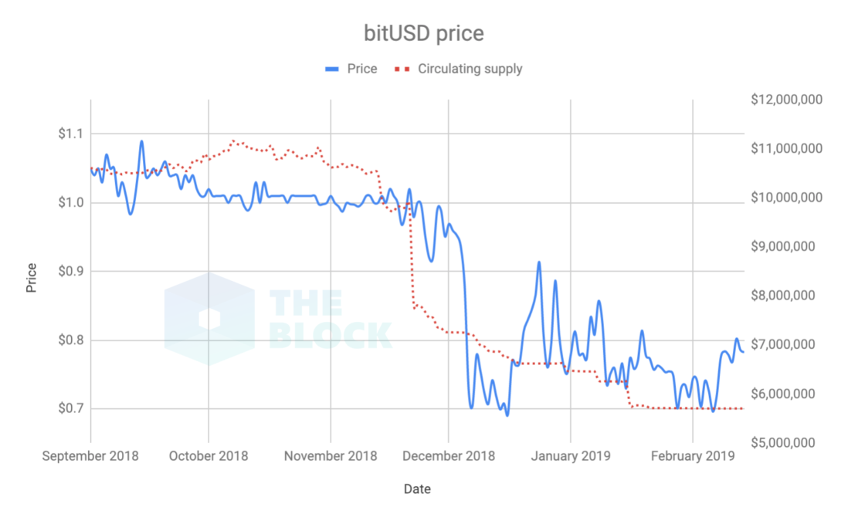
Native
All exchange operations performed on-chain, thus open to all people and assets.
Custom blockchains (BitShares, Waves) built to handle throughput required.
Lack of native tokens means assets created through central custody or synthetics.

Slide 11


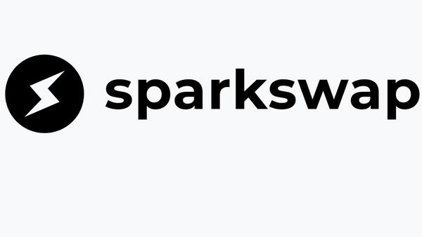
2011
HTLC
Native
Ring Exchange
Now

Slide 12

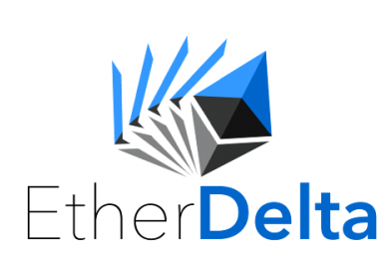
2011
HTLC
Native
Ring Exchange
On-Chain
Off-Chain
Now

Slide 13
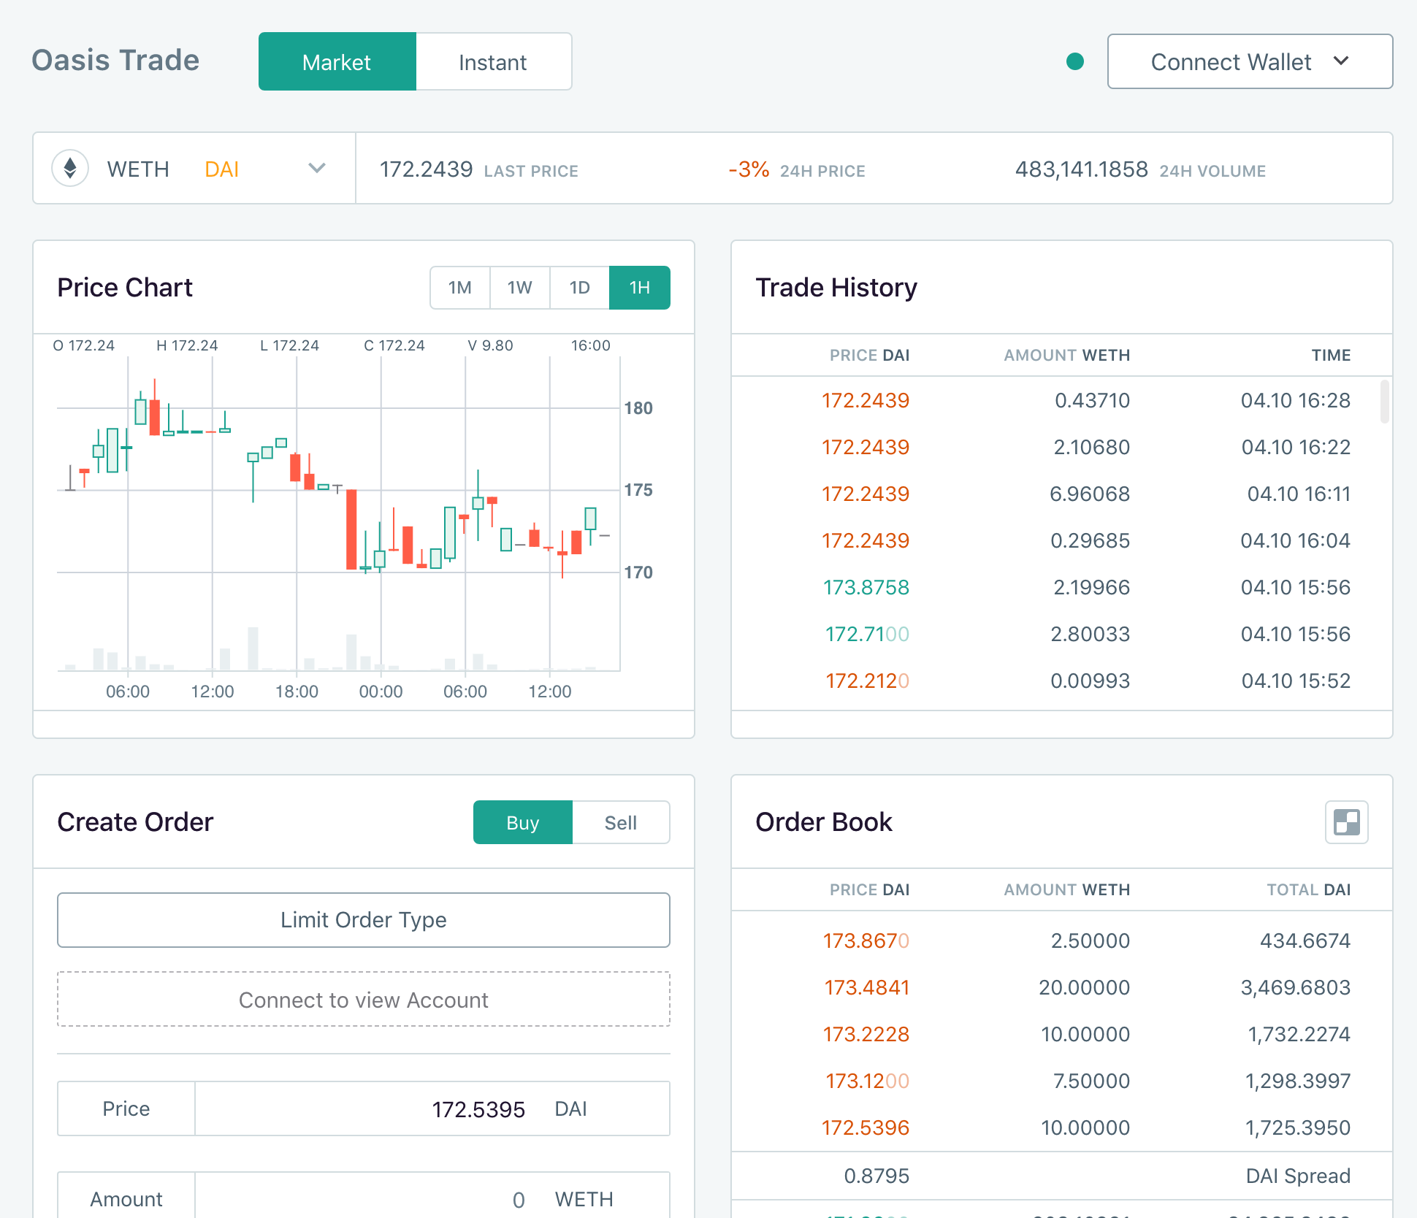
OasisDEX
Completely on-chain orderbook built by Maker to ensure liquidity for DAI and MKR.
Removed MKR in early 2019 and transitioned to eth2dai. Old contracts still live!
Ensures censorship-resistance at cost of additional gas.
Largest Ethereum DEX by $ volume (!)

Slide 14
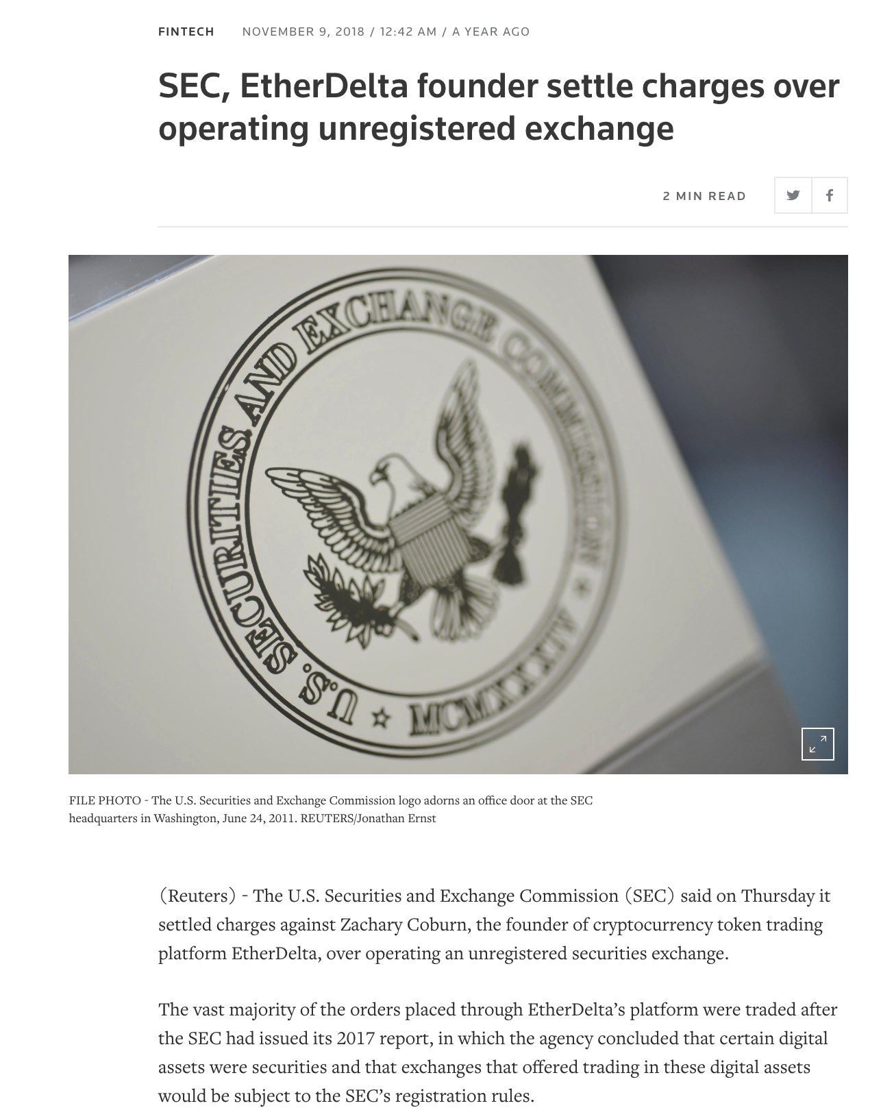
EtherDelta
Pioneered off-chain relay, on-chain settlement. Provided much needed performance without custody tradeoff.
Need a centralized orderbook operator, but custody risk is gone.
Regulatory status unfavorable. Need to separate software from software operator, especially when matching / filling orders.

Slide 15

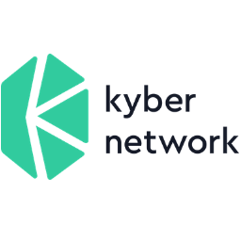




2014
Native
On-Chain
Off-Chain
Verticalized
Platform
AMM
Orderbook
Now

Slide 16
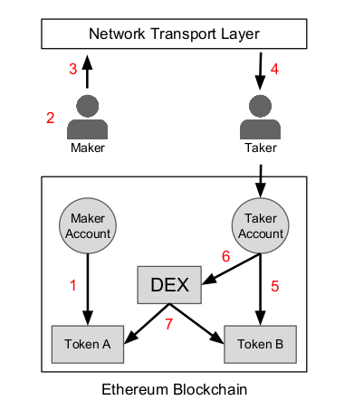
Off-chain Relay, On-Chain Settlement
Take what made EtherDelta great, and double down on it.
Many different permutations (open orderbook, quote providing, matching, etc.) for different needs. Also allows great flexibility on pricing, order structure, etc.
Still has centralization risk. Requires market makers to provide liquidity.

Slide 17



Off-chain Relay, On-Chain Settlement
0x is a platform for building decentralized exchanges, but does not operate an orderbook or UI.
DDEX and AirSwap have similar models, but more vertically-integrated.
App / UI
vs.
Protocol

Slide 18
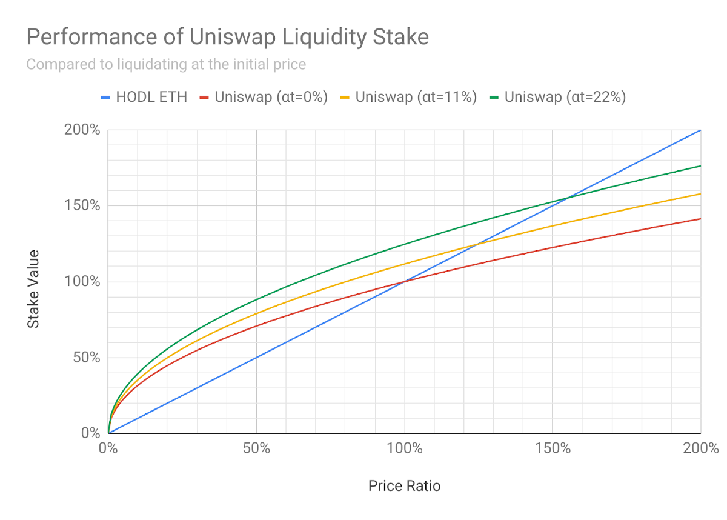
AMMs (“Automated Market Makers”)
Off-chain orderbook models still require market makers and central operators. Can be expensive and difficult to start.
AMMs allow anyone to start their own market and provide liquidity for it.
Market orders only and prone to high slippage. Sandwiching / frontrunning also possible, though mitigated. Requires retail volume to remain profitable.

Slide 19
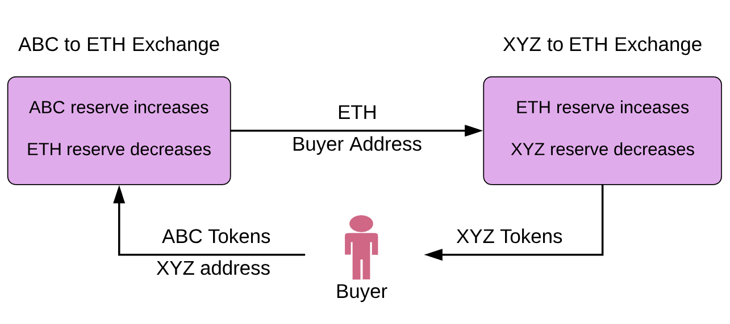
AMMs (“Automated Market Makers”)
Bancor popularized the concept, but handicapped by poor token model and hacks.
Uniswap built Bancor-style AMM as an open-source public good.
Balancer takes Uniswap model and extends it to indexes of tokens.

Slide 20
On-Chain Orderbooks
Allow liquidity providers to set their own quotes on-chain and route fills to the best quote.
Can also “wrap” other on-chain liquidity sources and turn them into reserves. Kyber now does 10% of Oasis and Uniswap volume.
Ensures that contract-fillable liquidity always available at cost of on-chain updates.
Kyber Proxy
Reserve A
Reserve B
Uniswap Reserve
Uniswap

Slide 21
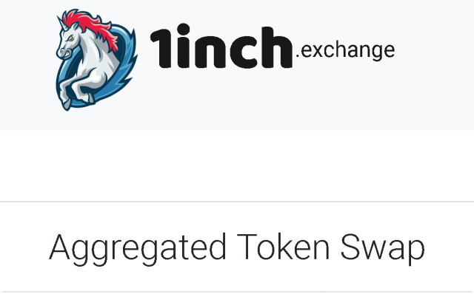
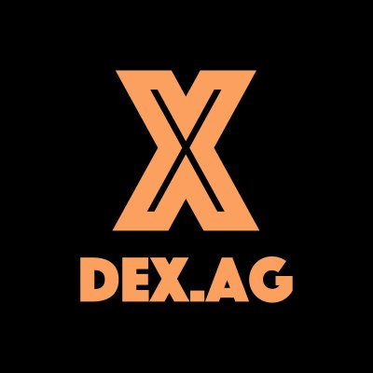

2016
Off-chain Verticalized
Off-Chain Platform
On-Chain Orderbook
AMM
Aggregation
Now

Slide 22
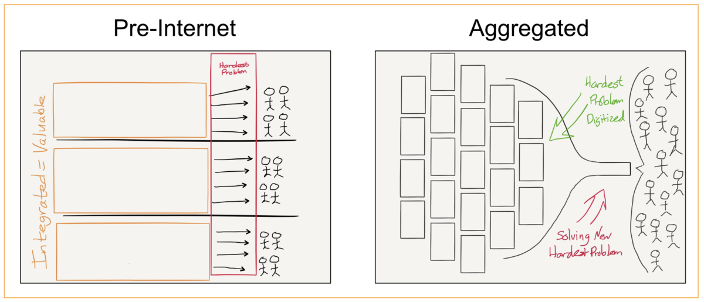
Aggregation Theory
Concept invented by Ben Thompson.
Internet technologies allow aggregators to commoditize their suppliers and capture most value.
Think Expedia for flights, Amazon for suppliers, Facebook for news, etc.
You want to be “above the API”, not “below the API”

Slide 23
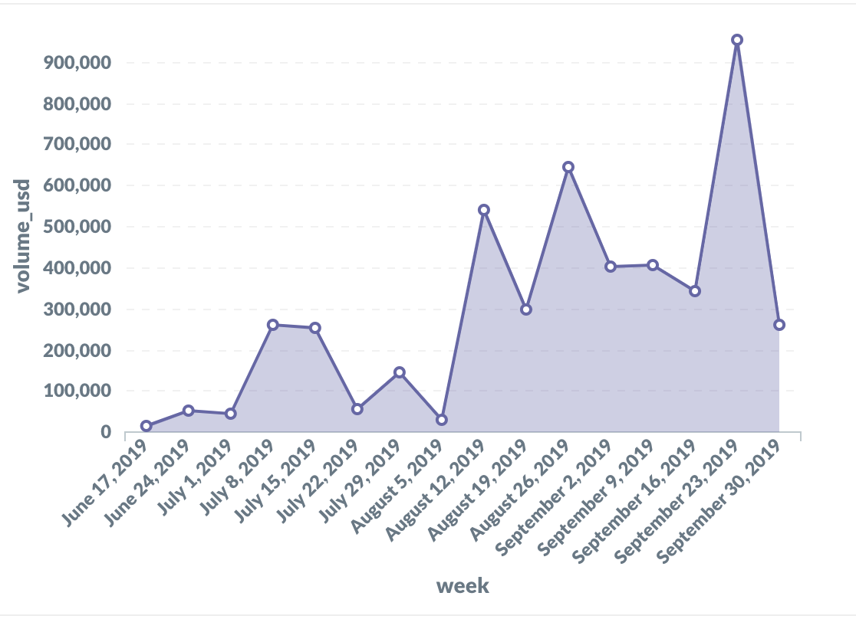
Aggregation Theory
When applied to DEXs, interfaces rule everything around to me.
DEXs become “liquidity suppliers” and must solely compete on best prices / assets to survive.
DEX.AG and 1inch now comprise 4% of all DEX volume (from 0% two months ago)
1inch Volume by Week

Slide 24
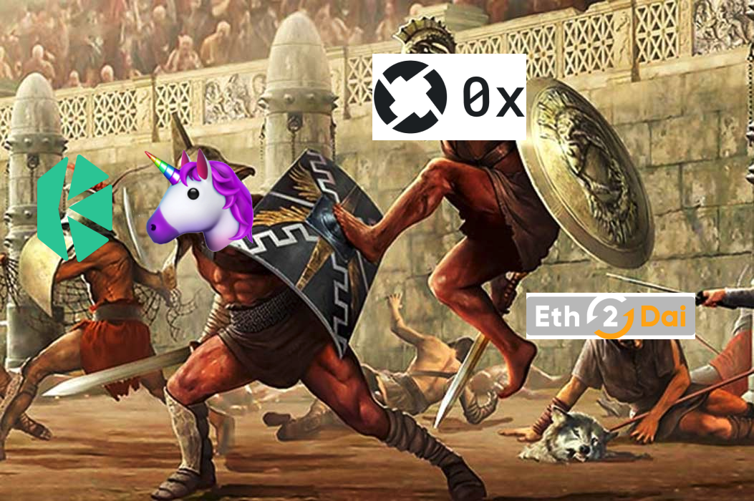
Aggregation Theory
When applied to DEXs, interfaces rule everything around to me.
DEXs become “liquidity suppliers” and must solely compete on best prices / assets to survive.
DEX.AG and 1inch now comprise 4% of all DEX volume (from 0% two months ago)

Slide 25
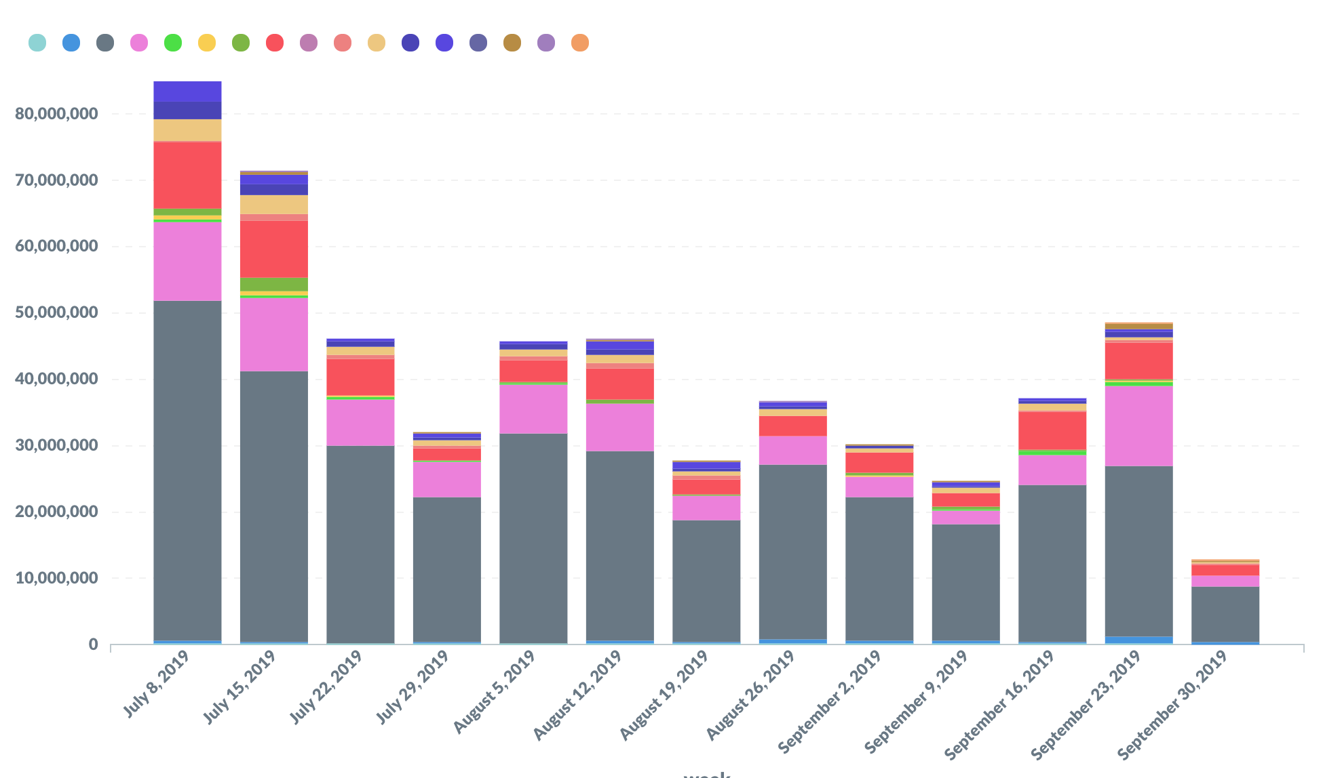
Onwards?
Layer 2 proliferation breaks many assumptions about DEXs today.
A large and increasing % of DEX volume is being filled by or through contracts.
DEX volume still a long ways off from matching CEX volume. Need to focus on unique value props of DEX.

Slide 26
Thank You

